Slide 1
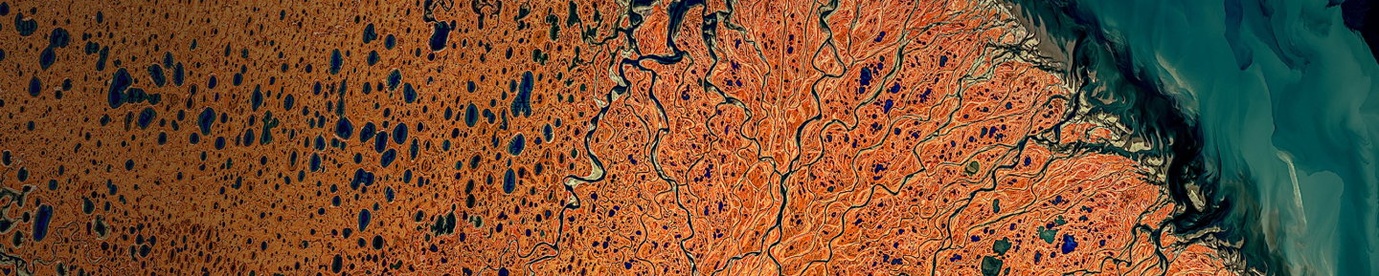
Lonboard: Fast, interactive geospatial data visualization
Kyle Barron
Development Seed
Notes:
Why? Then what? Then how?
This is in the geospatial track, but it could just as well be in the “playing nice: scientific programming across languages” track.

Slide 2
Goals:
Fast
Simple
Interactive
Notes:
Geospatial vector data is points, lines, polygons

Slide 3
…why not existing libraries?

Slide 4
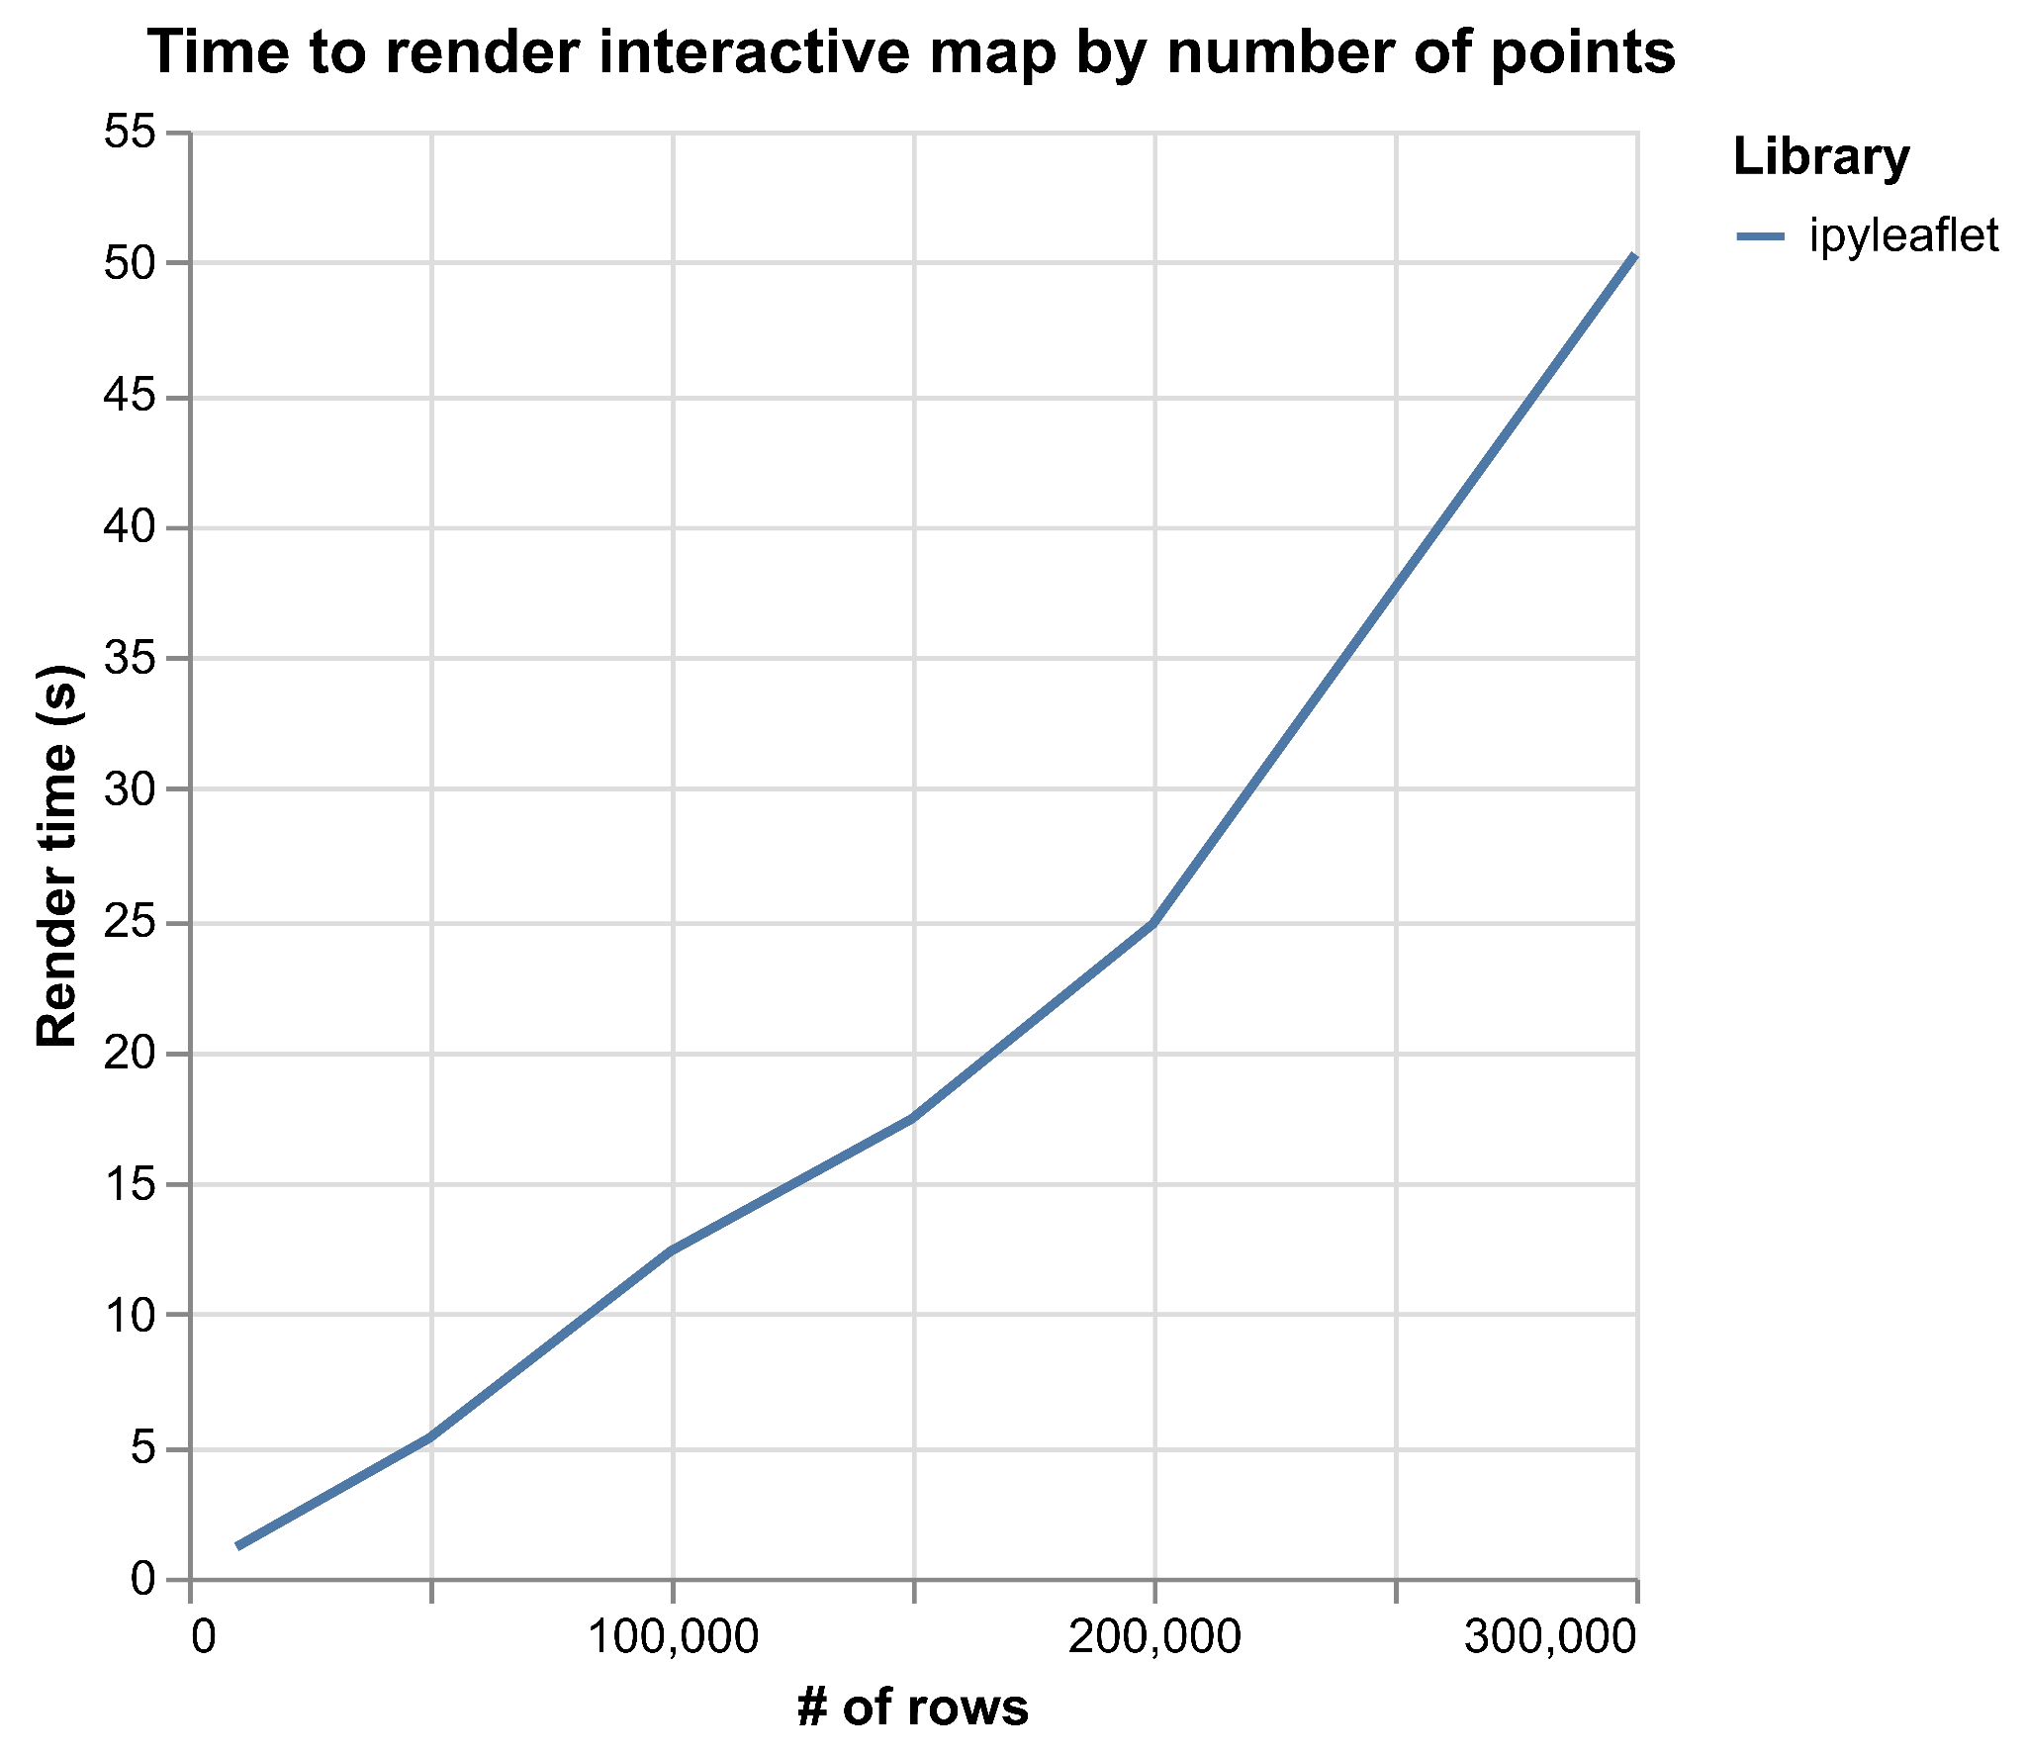
ipyleaflet?
Notes:
Failed at 400,000 points

Slide 5
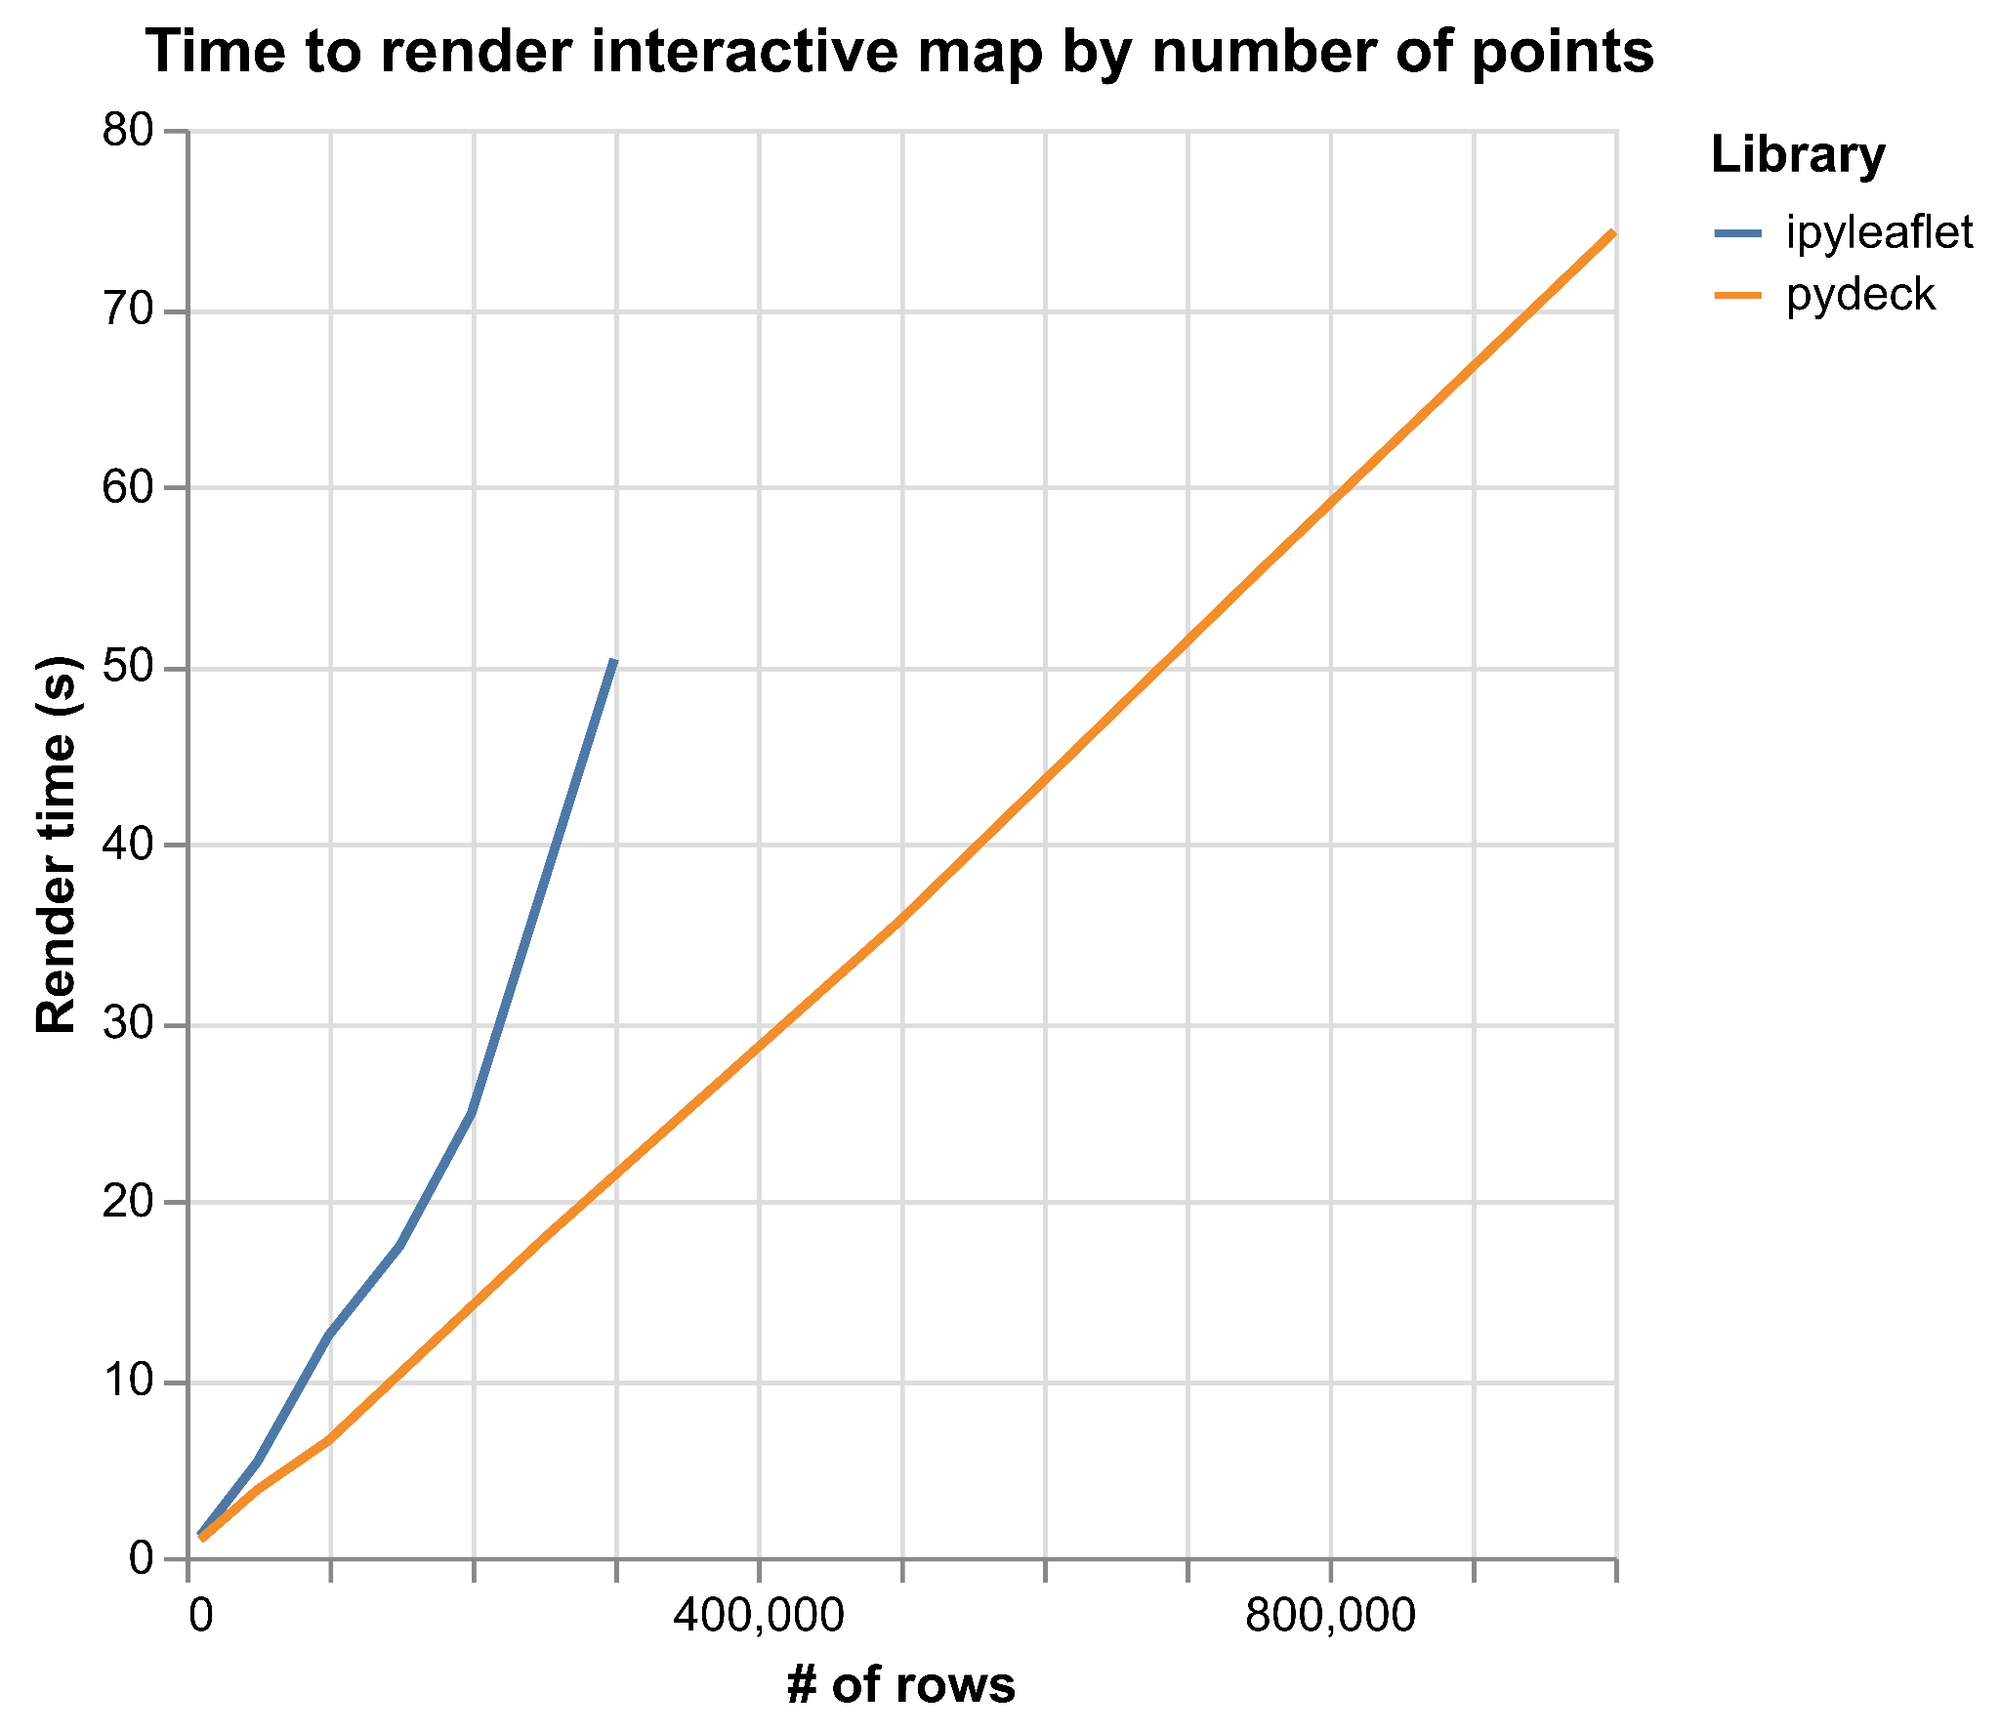
pydeck?
Notes:
Powered by deck.gl on the GPU
Failed at 1.2 million points (after 90 seconds)

Slide 6
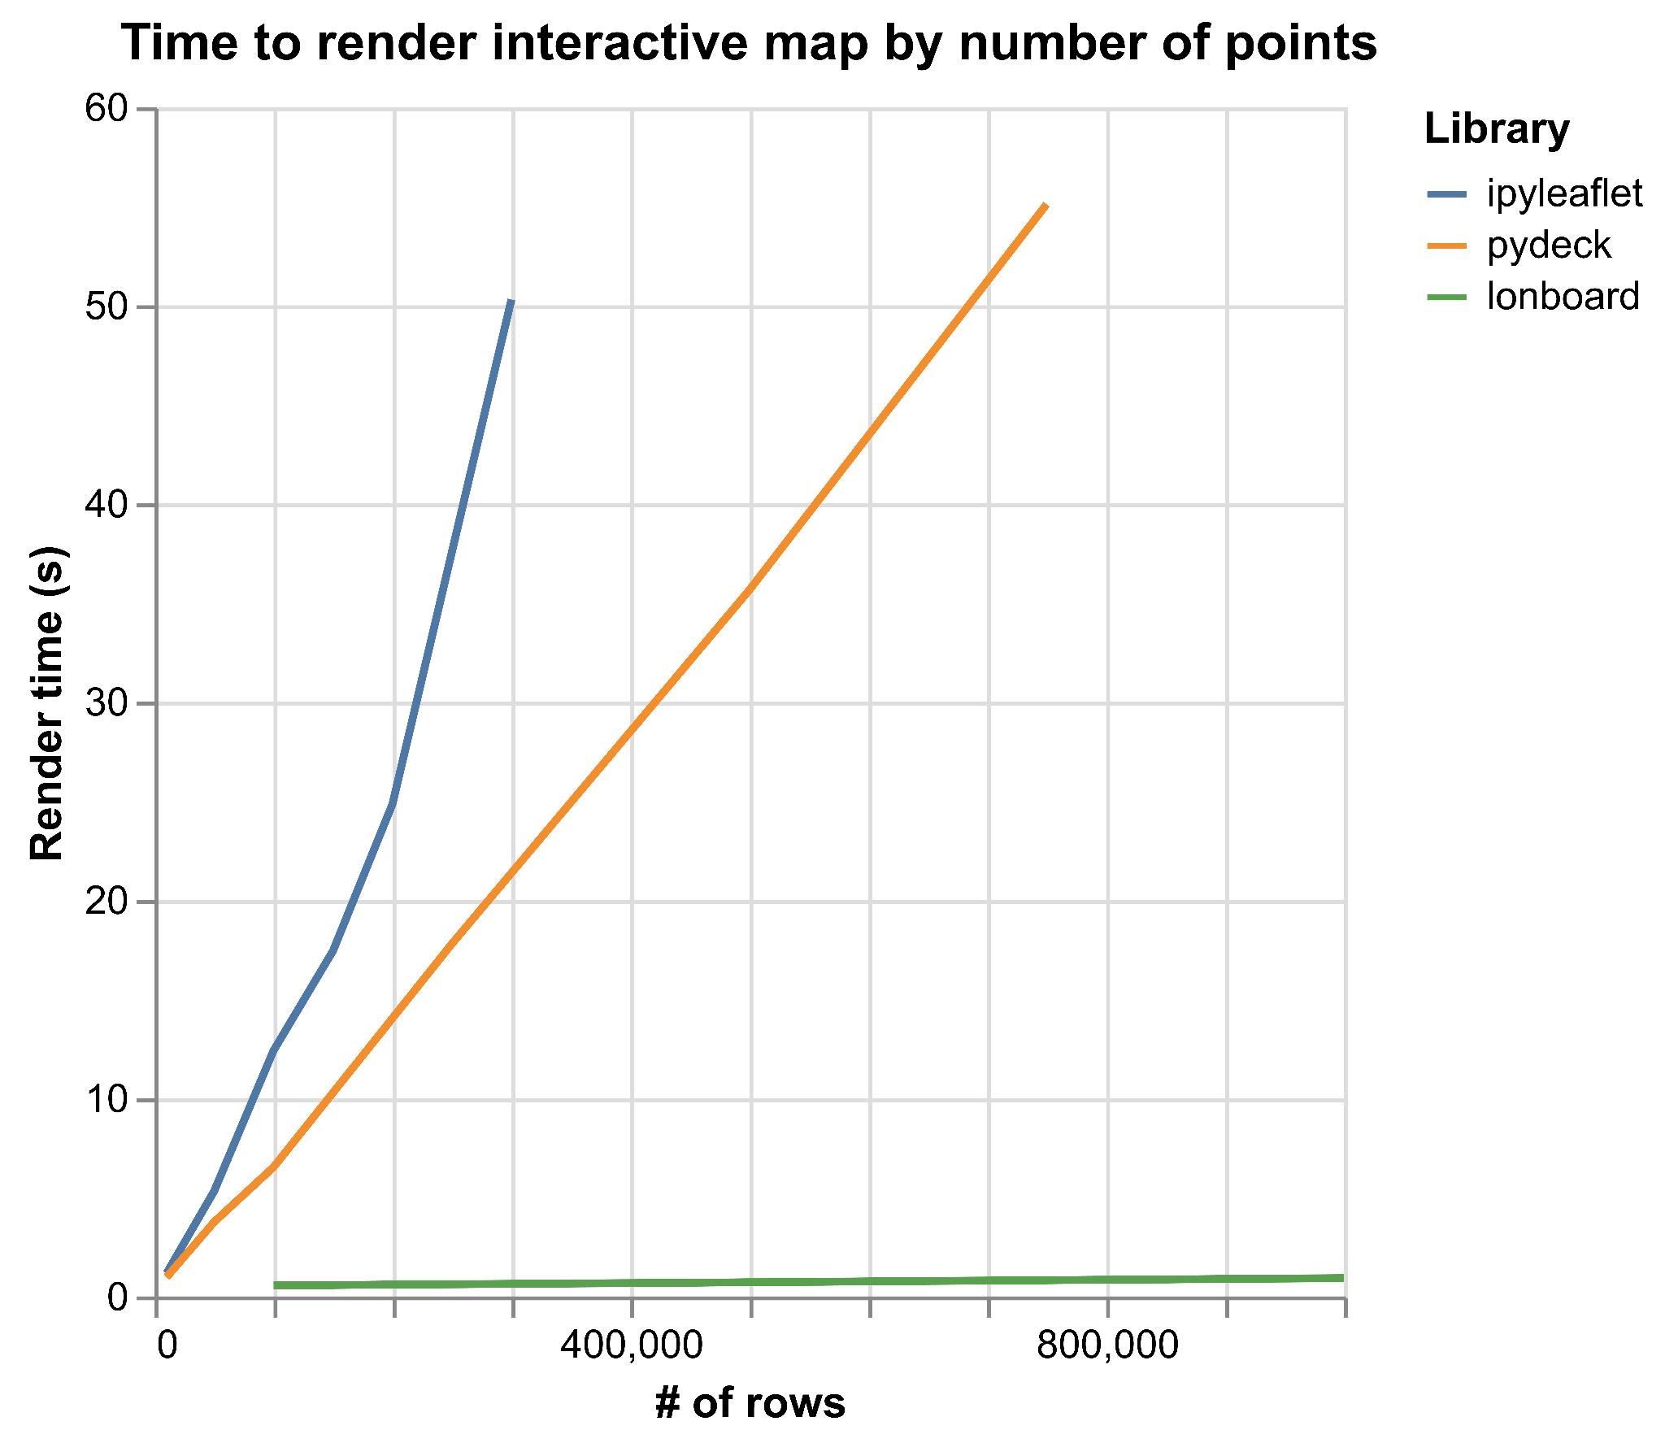
lonboard!
Notes:
Failed at 1.2 million points (after 90 seconds)

Slide 7
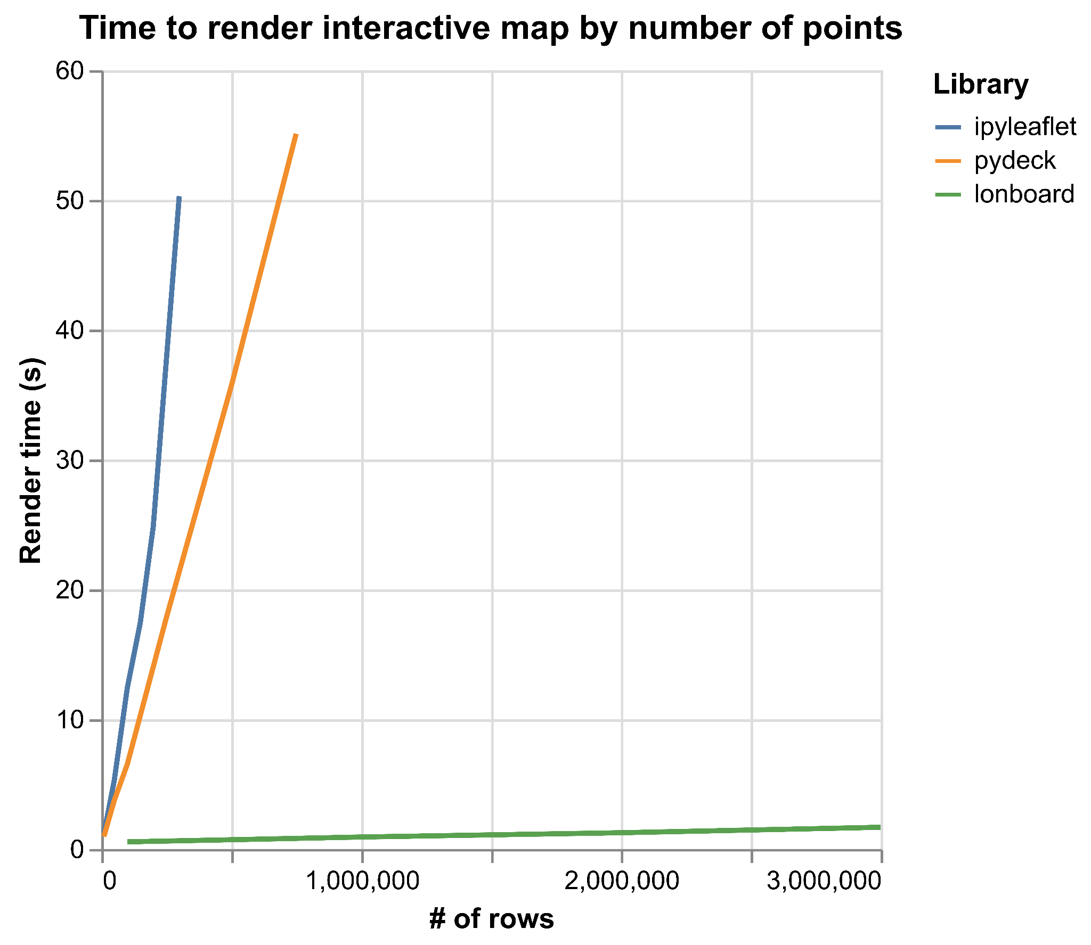
lonboard!
Notes:
Failed at 1.2 million points (after 90 seconds)

Slide 8
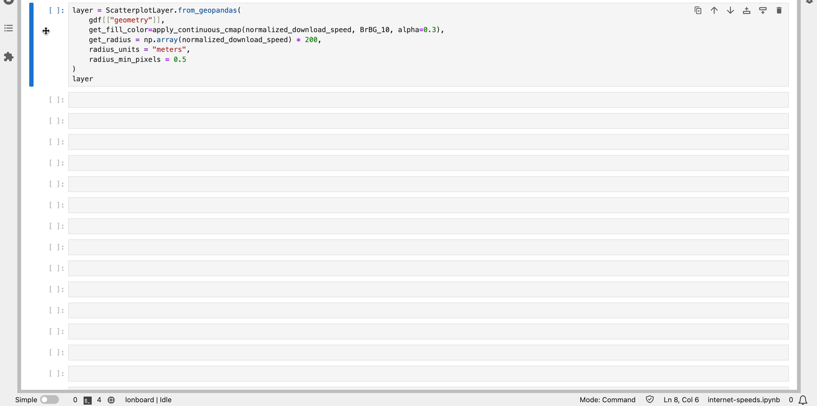
Lonboard: 3 million points in 2.5 seconds

Slide 9
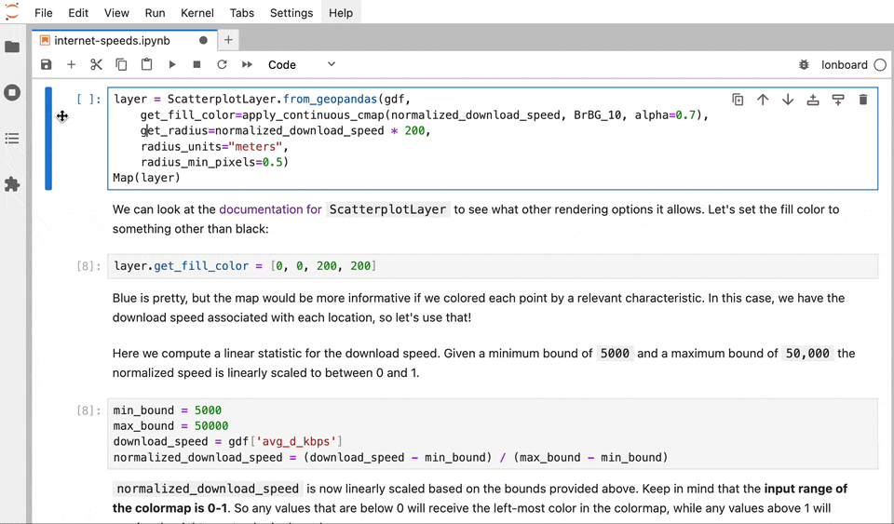
Interactive Data Exploration

Slide 10
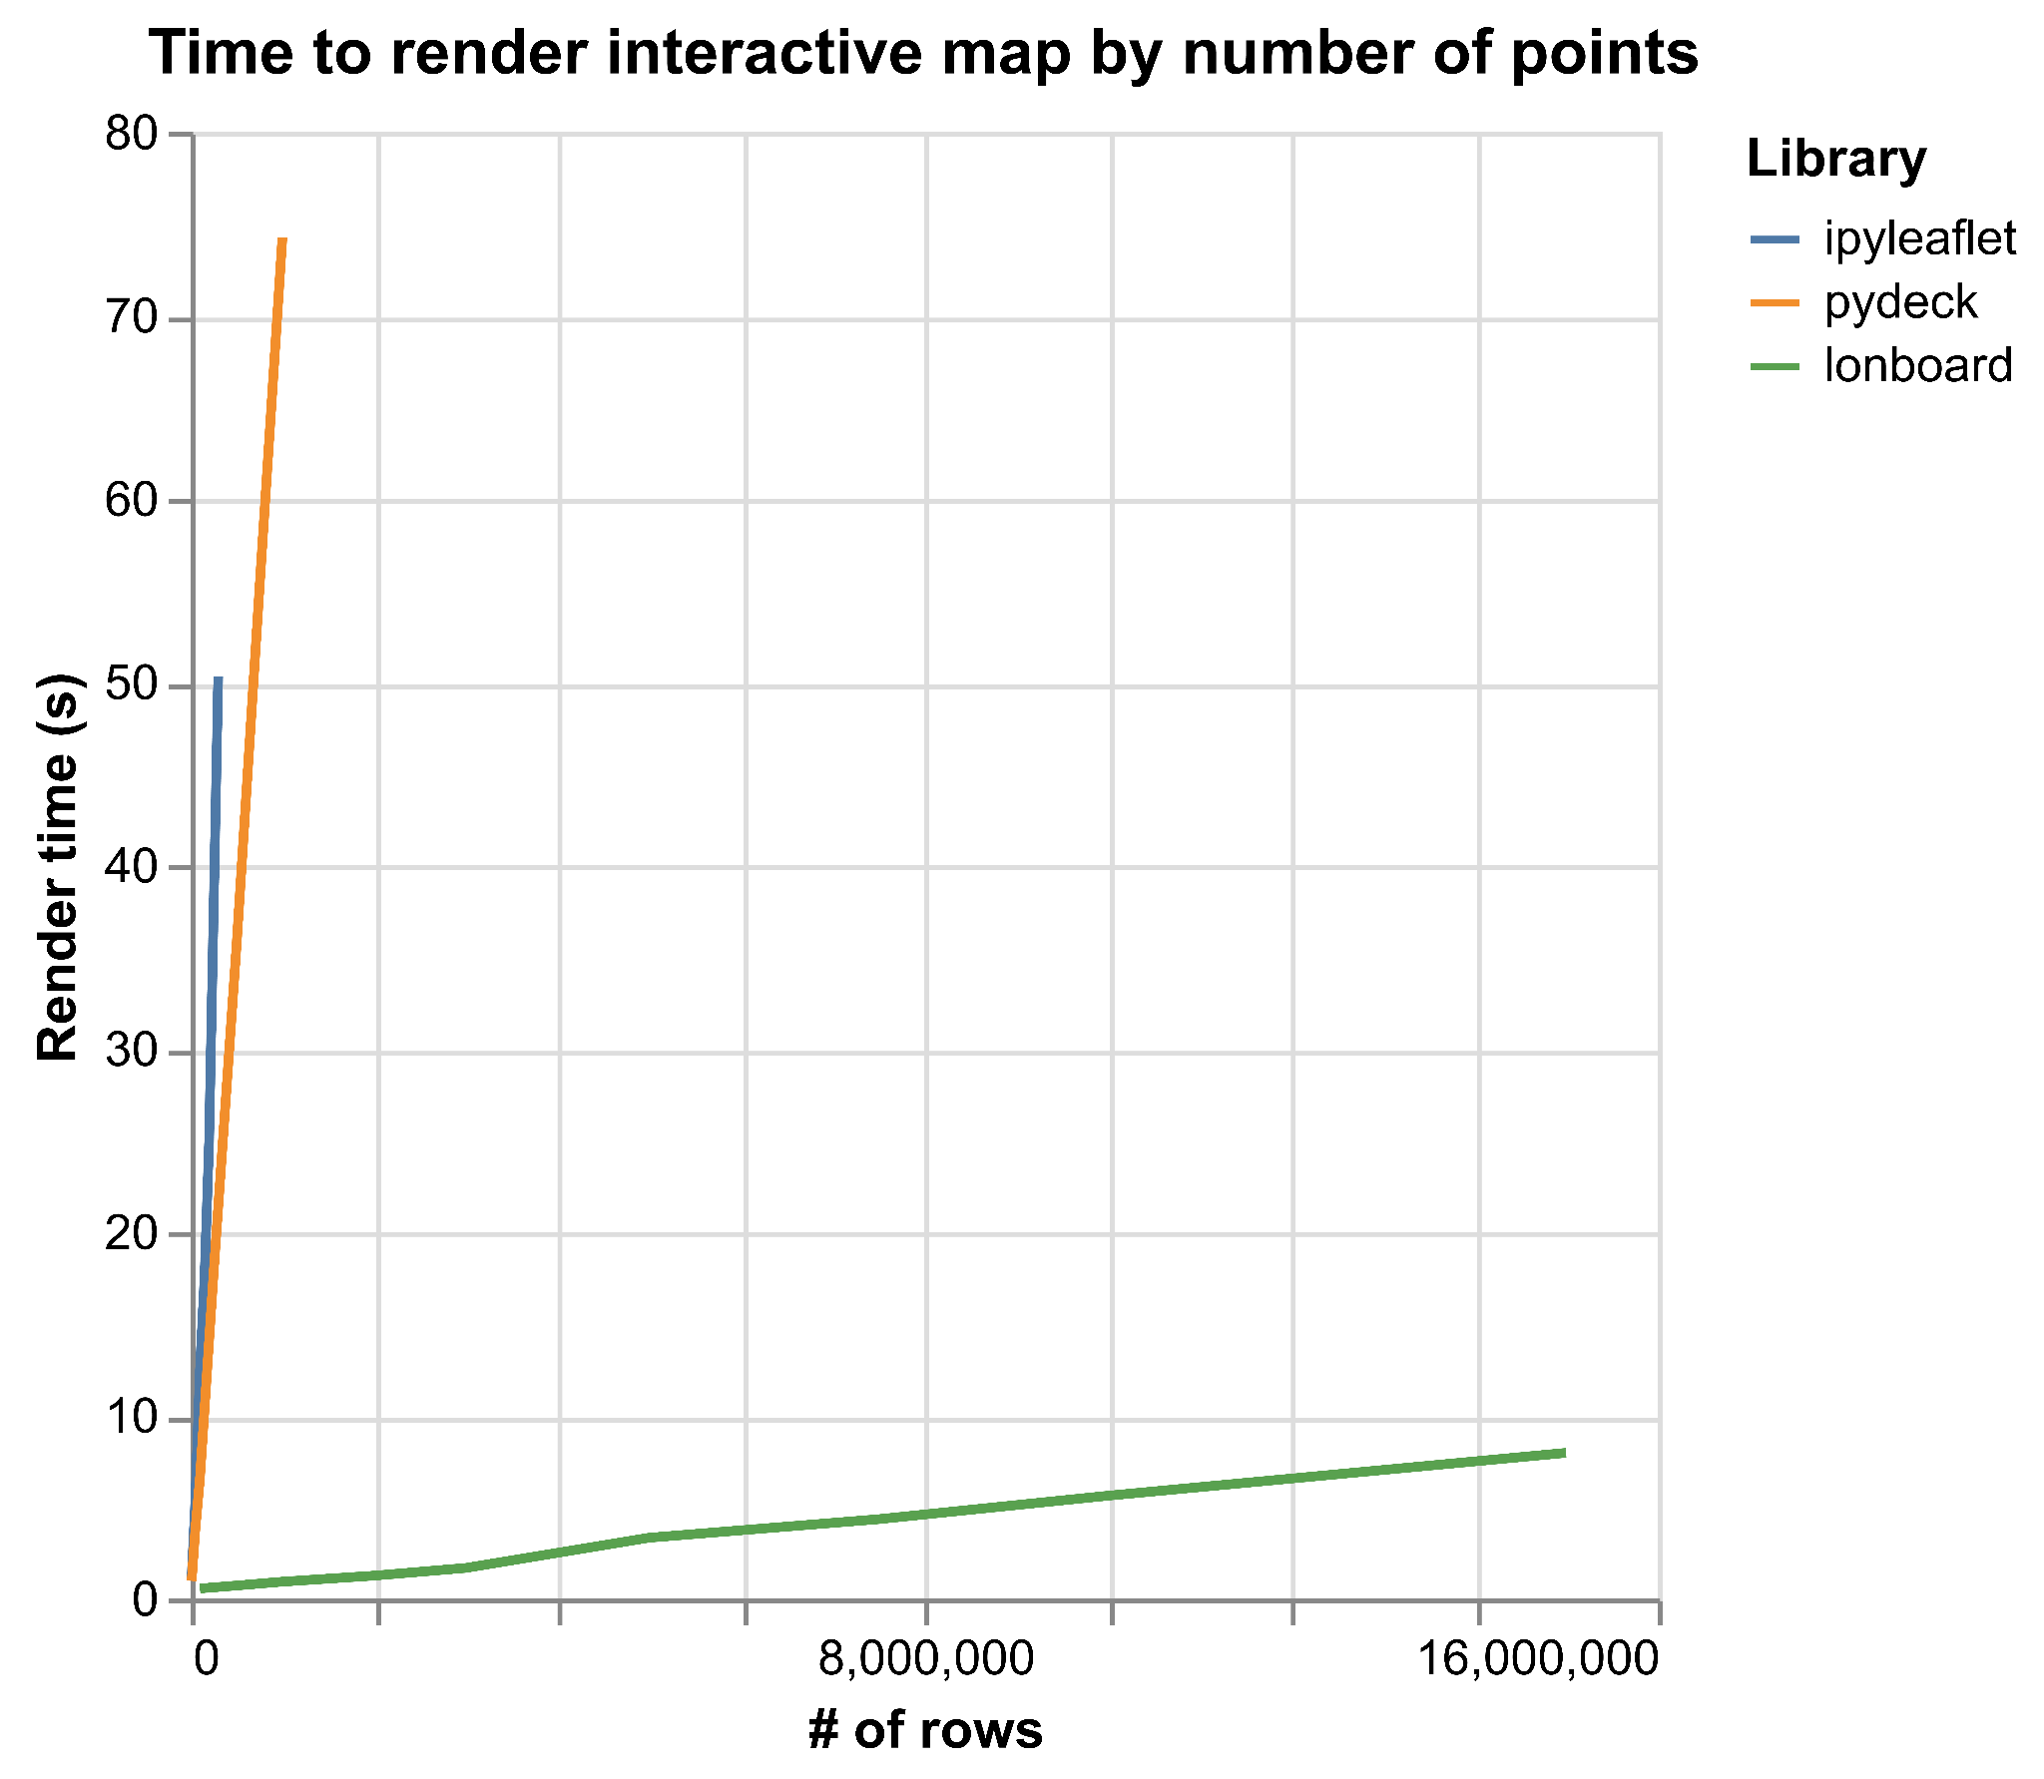
lonboard!
Notes:
Rendered 10 million points in the time it took ipyleaflet to render 50,000 points
Rendered 15 million points

Slide 11
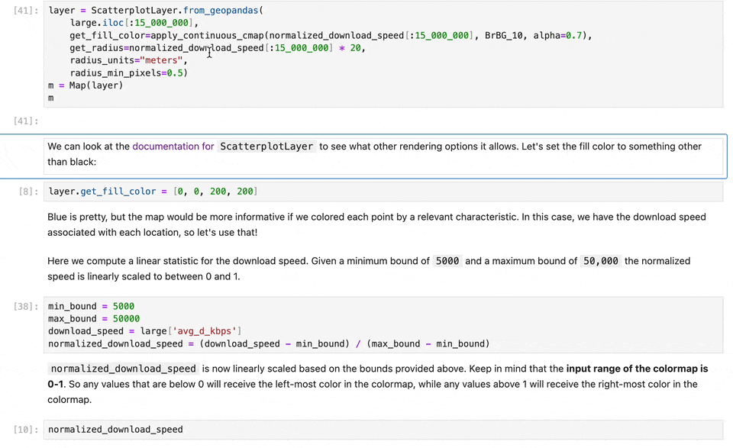
Laggy, but functional at 15M points

Slide 12
How is it so fast?

Slide 13
Data rendering on the web
Three parts of vector web maps
Load data to the browser
Manage data in memory
Render to screen
Notes:
A crucial part of this talk is JavaScript and the browser, because if you want to have interactivity, you need to use the browser.

Slide 14
Data rendering on the web
Three parts of vector web maps (slow)
Load data to the browser
Manage data in memory
Render to screen
GeoJSON
Massive file size
Very slow to read and write
No partial reads
GeoJSON-like JavaScript objects
Memory overhead
Can’t be shared with web worker or WebAssembly
High garbage collector overhead (many small JavaScript array objects)
Leaflet
Slow to iterate over input features and render to HTML canvas element
Notes:
Each part can be bottleneck

Slide 15
Binary data pipelines are fast
Three parts of vector web maps (fast)
Load data to the browser
Manage data in memory
Render to screen
GeoParquet
Fastest way to move data
Efficient compression
Remote partial reads (cloud-native)
Spatial/column selection
Very fast to read and write
GeoArrow
Most efficient way to represent geospatial DataFrames
Binary buffers store entire column’s data
No serialization to share with web worker or WebAssembly
No garbage collector overhead
deck.gl
Fastest analytical map rendering on the web
Copy directly from GeoArrow memory to the GPU
Instanced (vectorized) draw calls
Notes:
Enabled by both server & client advancements
Each part minimizes bottleneck

Slide 16
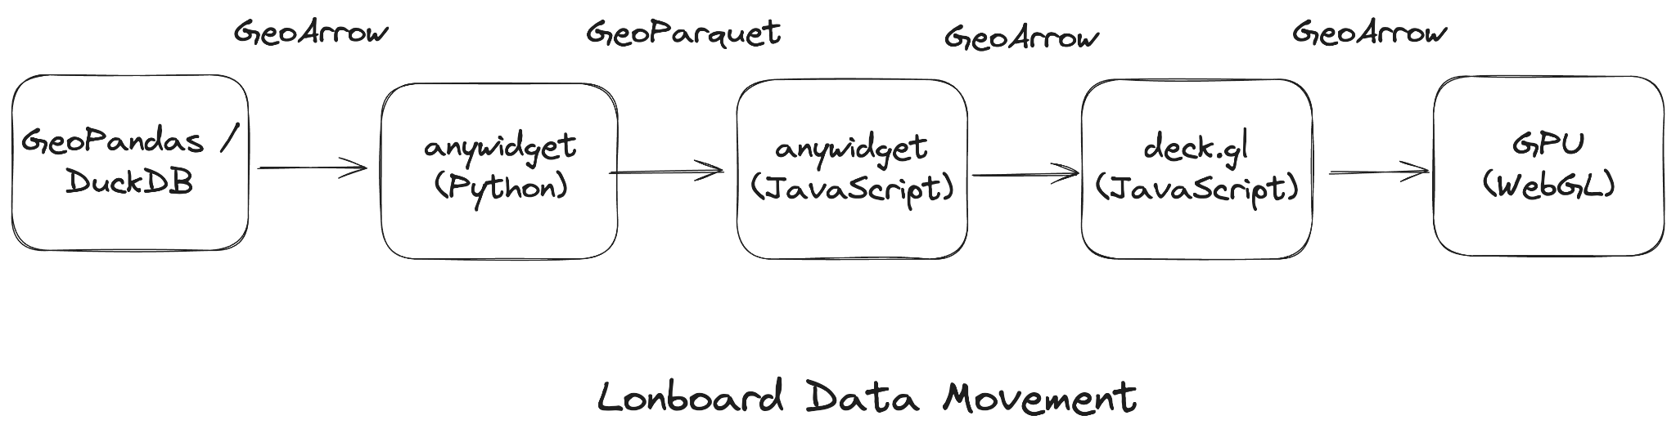
End-to-end binary data pipeline
Notes:
GPU doesn’t matter if you’re CPU-limited
GeoArrow & GeoParquet throughout the data pipeline.
Python: GeoPandas to GeoArrow to Parquet.
Transfer compressed binary buffers to the Browser.
JavaScript: Decode Parquet to GeoArrow.
deck.gl: Pass GeoArrow buffers to the GPU.

Slide 17
Simple to use

Slide 18
High-level API
Integrates with existing libraries
GeoPandas GeoDataFrame, GeoSeries
Shapely array, scalar
DuckDB Spatial query
GDAL (pyogrio)
Ibis (in progress)
Any GeoArrow Python object

Slide 19
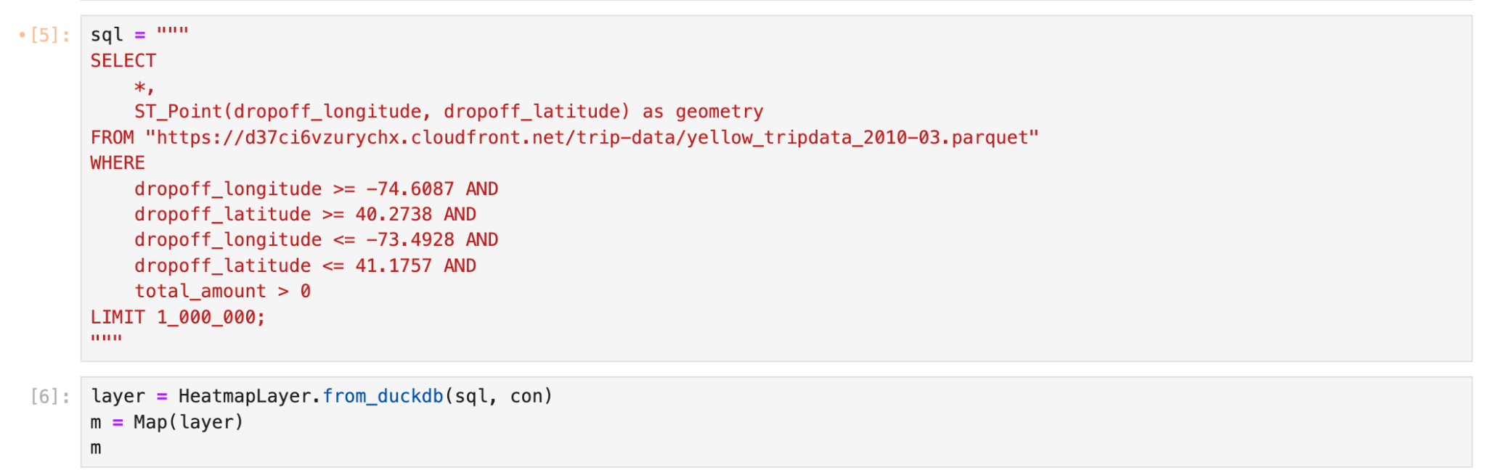
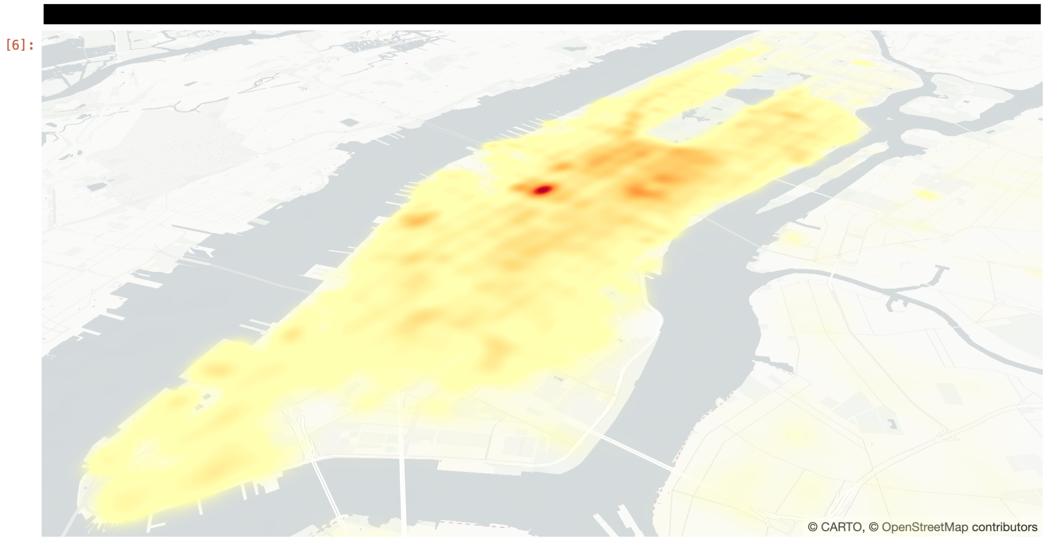
High-level API
DuckDB Integration
Pass query into from_duckdb

Slide 20
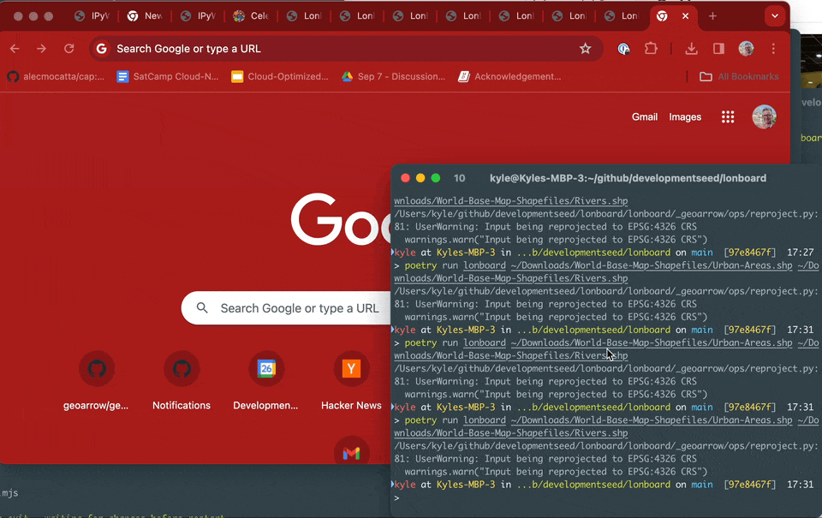
High-level API
CLI Included

Slide 21
Interactive exploration

Slide 22
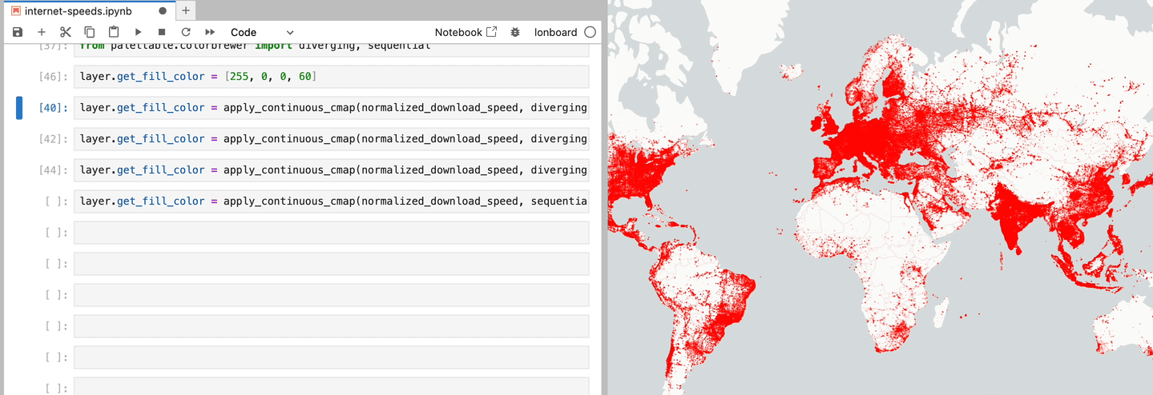
Swap colormaps in a fraction of a second

Slide 23
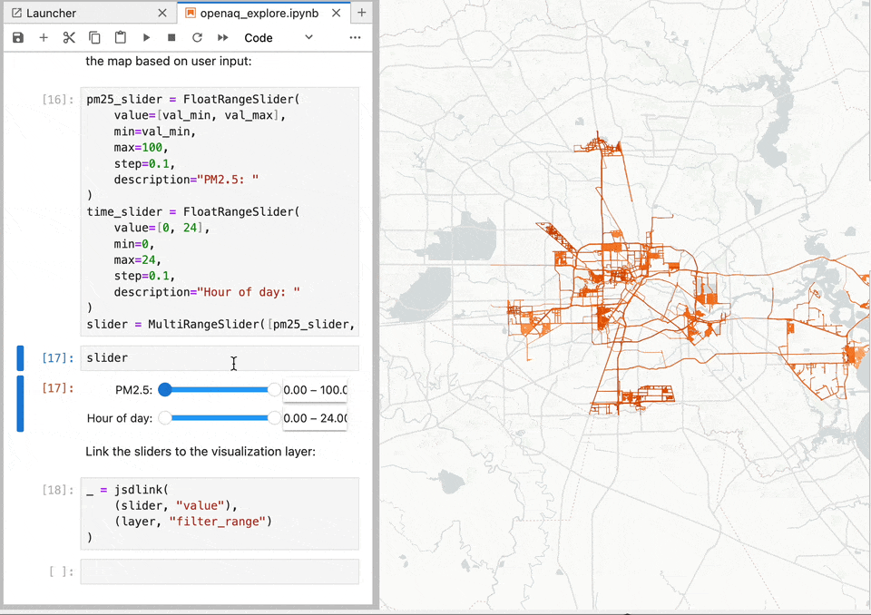
GPU Data Filtering

Slide 24
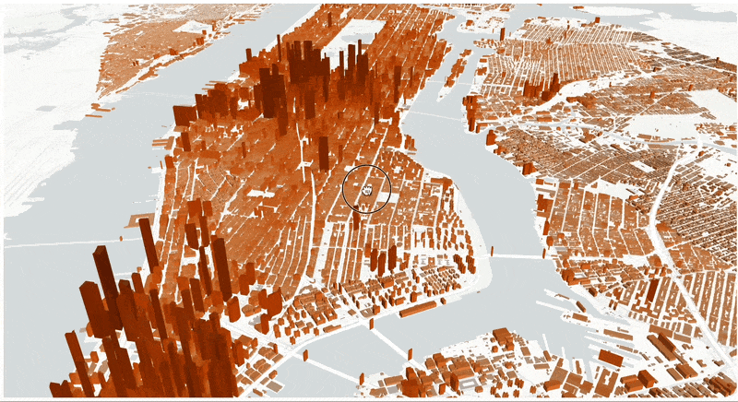
Buildings data

Slide 25
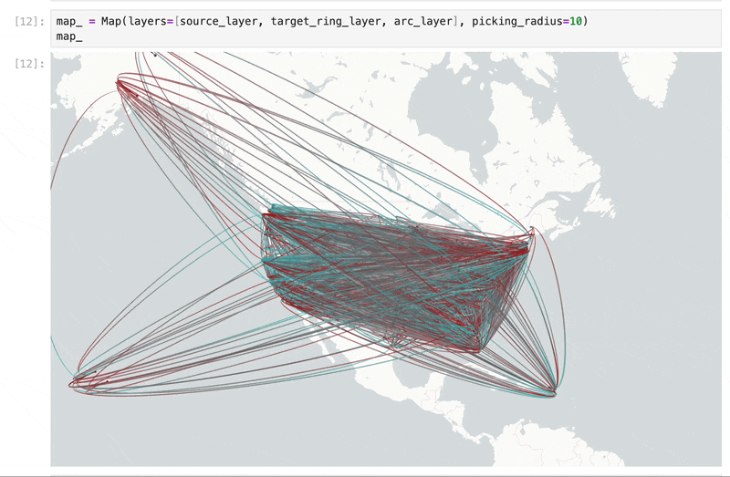
County-to-County Migration

Slide 26
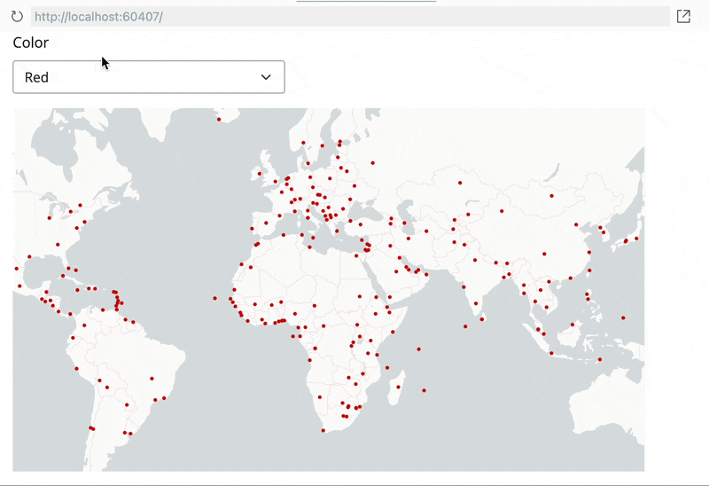
Dashboard integration
e.g. Shiny, Panel

Slide 27

What’s in a name?
A "deck" is the part of a skateboard you ride on. What's a fast, geospatial skateboard?
A lonboard.
Credit Kiri Carini & Dall-E & internet skateboarders’ training data

Slide 28
Future work

Slide 29
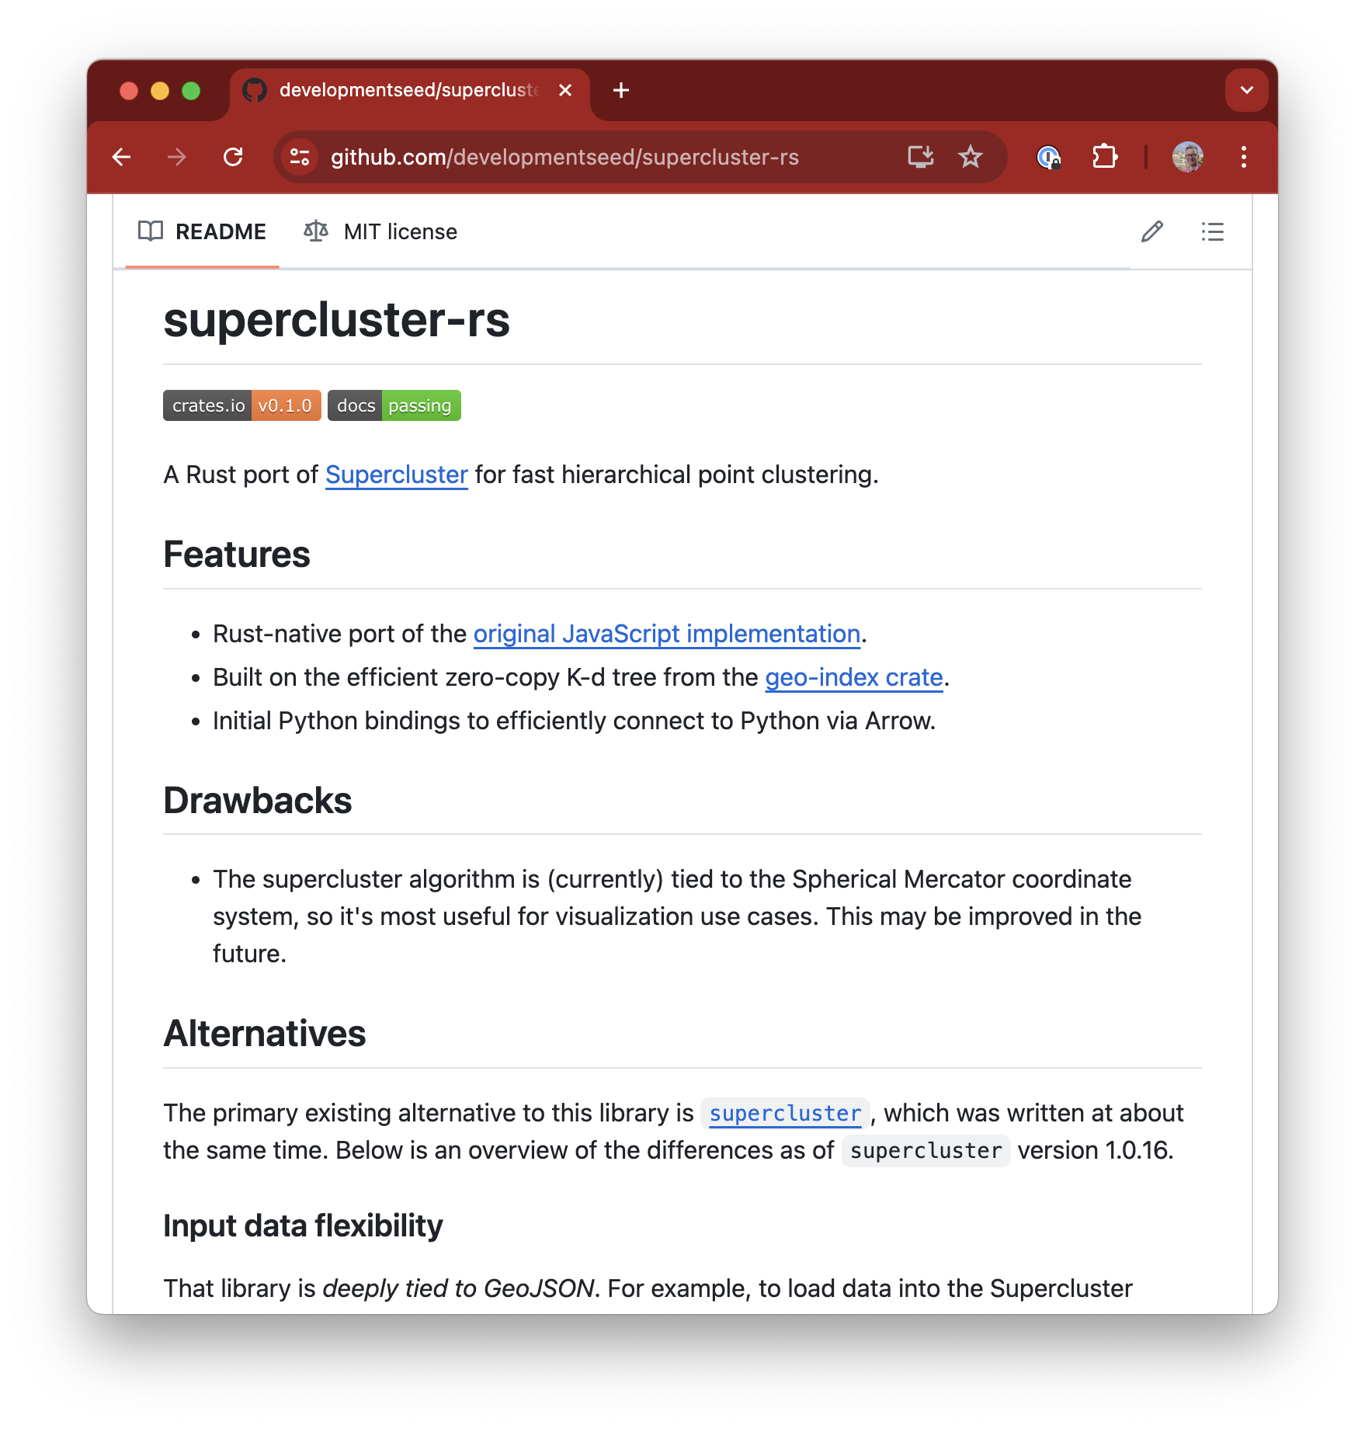

Scalable rendering
Today all user input is sent to browser
In the future:
Smarter relationship between Python and JavaScript
Efficient spatial indexes in Rust/Python
Transfer small portions of input, depending on map’s view

Slide 30
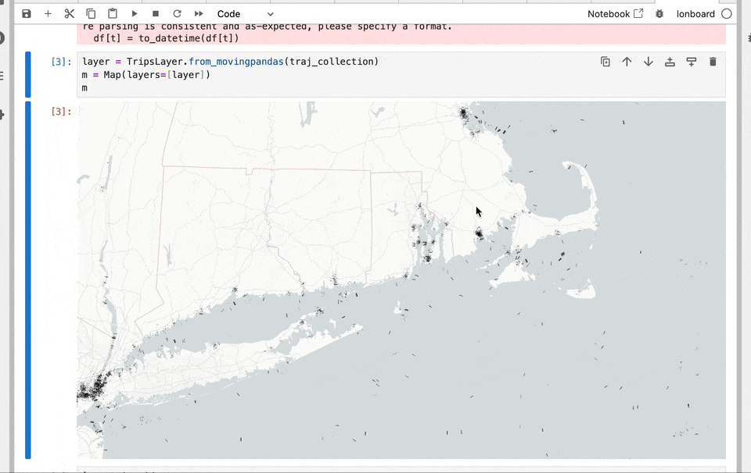
ds.io/lonboard
Future Work: Trajectory data

Slide 31
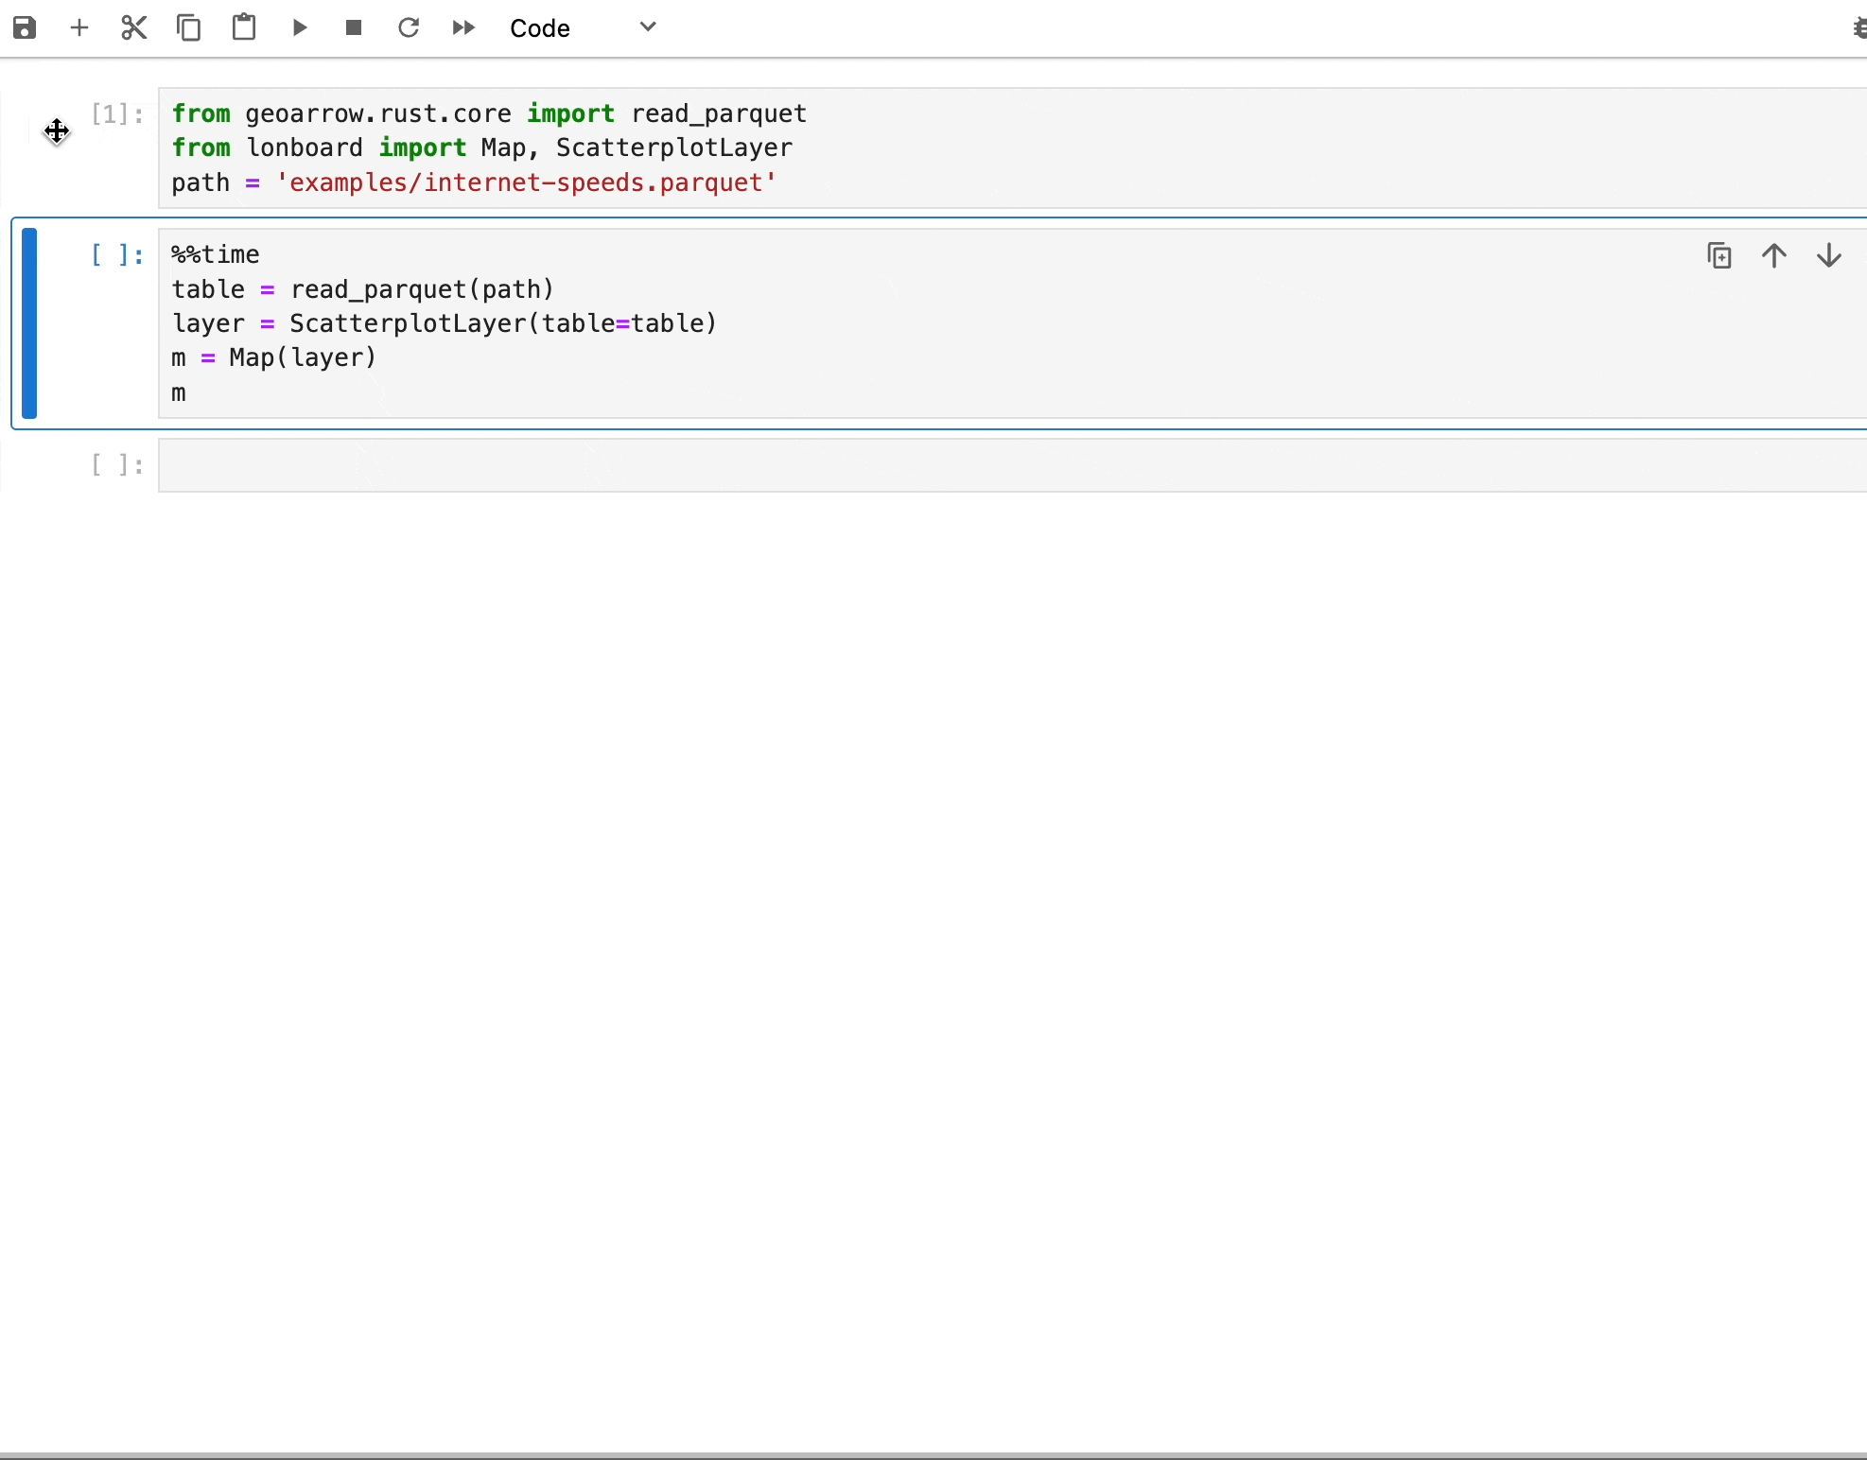
geoarrow-rust -> Lonboard
1.6s to render 3 million points from disk
Load GeoParquet file from Rust, then pass to Lonboard
Rust -> Python -> pyarrow (C++) without copies

Slide 32

Learn More
ds.io/blog
ds.io/Lonboard
geoarrow.org
Trevor’s anywidget talk from yesterday
Podcasts:
Mapscaping (GeoParquet)
Matt Forrest (Lonboard & GeoArrow)
Browsertech (JavaScript/WebAssembly)

